Slide 1
Inventory and Asset Management
By
Mr. Nathawut Supavananusorn 542115020
Mr. Tanadol Parn-ong 542115021
Notes:
This template can be used as a starter file for presenting training materials in a group setting.
Sections
Right-click on a slide to add sections. Sections can help to organize your slides or facilitate collaboration between multiple authors.
Notes
Use the Notes section for delivery notes or to provide additional details for the audience. View these notes in Presentation View during your presentation.
Keep in mind the font size (important for accessibility, visibility, videotaping, and online production)
Coordinated colors
Pay particular attention to the graphs, charts, and text boxes.
Consider that attendees will print in black and white or grayscale. Run a test print to make sure your colors work when printed in pure black and white and grayscale.
Graphics, tables, and graphs
Keep it simple: If possible, use consistent, non-distracting styles and colors.
Label all graphs and tables.

Slide 2
Agenda
Introduction & Literature Review
Problems
Motivation
Aim & objective
Business Review
Smart course management in cloud
Overall system architecture
Technology Review
Limitation
Future work
Development model
Schedule & Milestone
Notes:
Give a brief overview of the presentation. Describe the major focus of the presentation and why it is important.
Introduce each of the major topics.
To provide a road map for the audience, you can repeat this Overview slide throughout the presentation, highlighting the particular topic you will discuss next.

Slide 3

Introduction
&
Literature Review
Notes:
This is another option for an Overview slides using transitions.

Slide 4
The IT staff’s problem
Spend a lot of time to record the details or plan to purchase a new durable articles.
Difficult to analyze the brand of durable articles that’s often loses.
Inform to repair is many processes and take a lot of times.
Provide the job’s durable articles not be equal.
To late for repairing durable articles.
Notes:
What will the audience be able to do after this training is complete? Briefly describe each objective how the audience will benefit from this presentation.

Slide 5
Motivation
We are going to develop Inventory and Asset Management system, which support on web application in order to provide convenient to Administrator, Technician, and Reporter, they can access to this system in everywhere by using the internet. This system is designed for durable articles management and durable articles repairing of College of Arts, Media and Technology.
Notes:
What will the audience be able to do after this training is complete? Briefly describe each objective how the audience will benefit from this presentation.

Slide 6
Aims & Objectives
The aims of this project are three parts.
The first part is to develop the web application which supports user management, durable articles management, editing administrator information, and providing Management Information system of durable articles.
The second part is to develop the web application which supports viewing the progress of repairing, updating repairing status of media, and editing technician information.
The third part is to develop the web application which supports informing broken durable articles detail to a technician, viewing the progress of repairing status, viewing his report history, and editing reporter information.
Notes:
What will the audience be able to do after this training is complete? Briefly describe each objective how the audience will benefit from this presentation.

Slide 7
Aims & Objectives
Objectives
To develop a web application that provides more convenience to administrator, technician, and reporter by inventing more function for support administrator, technician, and reporter within College of Arts, Media and Technology.
Notes:
What will the audience be able to do after this training is complete? Briefly describe each objective how the audience will benefit from this presentation.

Slide 8
Business Review

Slide 9
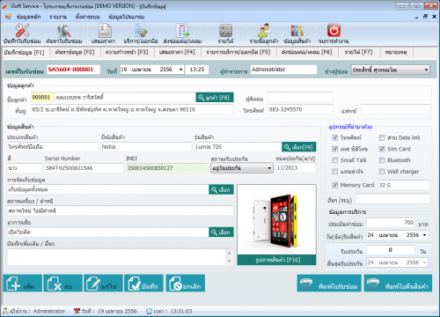
iSoftService
iSoftService is an application about repair management system. The repair center can use this system to manage the product repairing, and notify to technicians about their work. This system provides the user to get a servicing report.
Notes:
What will the audience be able to do after this training is complete? Briefly describe each objective how the audience will benefit from this presentation.

Slide 10
iSoftService
Pros
Recording repairing information
Finding servicing information
Calculating income
Servicing collaboration between departments in the service center.
Cons
No the tracking system
No the system for help to distribute works of each technician equally.
Function complexity, so this system is hard to use for beginning user.
Notes:
What will the audience be able to do after this training is complete? Briefly describe each objective how the audience will benefit from this presentation.

Slide 11
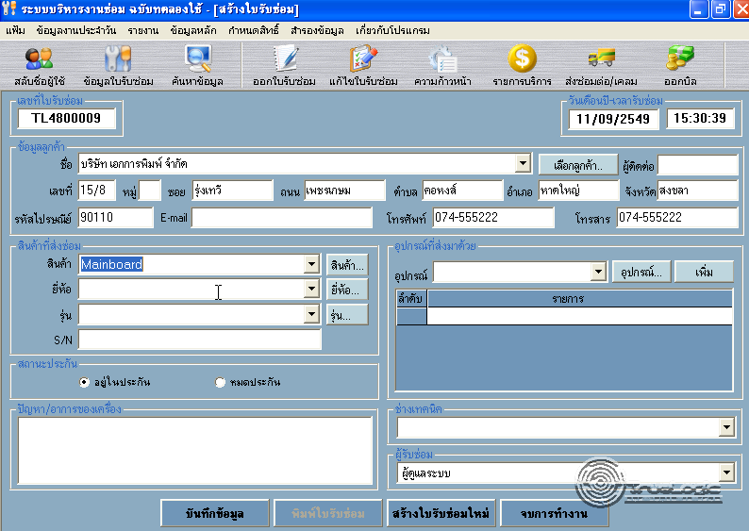
Service Center
Service Center is developed for repairing management. This system uses for repair and installation, such as appliance repair service center, PC repair shop, and mobile repair shop. This system is convenient for the general repair shop.
Notes:
What will the audience be able to do after this training is complete? Briefly describe each objective how the audience will benefit from this presentation.

Slide 12
Service Center
Pros
Convenient to repairing technicians.
User account and user permission system.
Searching information.
Cons
No the tracking system
No the system for help to distribute works of each technician equally.
Function complexity
Notes:
What will the audience be able to do after this training is complete? Briefly describe each objective how the audience will benefit from this presentation.

Slide 13

All of the problem can solve
by using ……

Slide 14
Inventory and Asset Management
Notes:
Use a section header for each of the topics, so there is a clear transition to the audience.

Slide 15
Inventory and Asset Management
Basic function to manage the durable articles (add, update, delete durable articles information).
Reporting the brand of durable articles that’s often loses
Reporting the durable articles almost expire.
Provide the statistics of inform to repairing durable articles for each month.
Help IT staff to manage and plan about the durable articles.
Make the staff to be equal in the job for each one.
Update the predicament’s durable articles by Email.
Notes:
What will the audience be able to do after this training is complete? Briefly describe each objective how the audience will benefit from this presentation.

Slide 16
System architecture

Slide 17
System architecture
Notes:
What will the audience be able to do after this training is complete? Briefly describe each objective how the audience will benefit from this presentation.

Slide 18
Technology Review

Slide 19

ASP.NET MVC
The concept of MVC design pattern will manage (separate) task and element in application to easy for building and development.
Why we use ASP.NET MVC
Can build dynamic web application.
Easy to adapt OOP concept.
Notes:
What will the audience be able to do after this training is complete? Briefly describe each objective how the audience will benefit from this presentation.

Slide 20

Cascading Style Sheets 3 (CSS3)
CSS3 is commonly used to create interfaces written in HTML and XHML.
Why we use CSS3
Easy to implement page layout.
Be considered a clean coding technique.
Can work with HTML5.
Notes:
What will the audience be able to do after this training is complete? Briefly describe each objective how the audience will benefit from this presentation.

Slide 21

HTML
HTML use Tag for define HTML displaying. HTML language is a Markup language that use for building web pages.
Why we use HTML
Can access sites easier than older version.
Support multimedia content.
Standardized for creating the user
interface of website.
Notes:
What will the audience be able to do after this training is complete? Briefly describe each objective how the audience will benefit from this presentation.

Slide 22

JavaScript
JavaScript is also used in server-side programming and building games as well as desktop and mobile applications.
Why we use HTML
Can use for calculating data, displaying, sending – receiving data for interacting with the user.
Easy to learn.
Notes:
What will the audience be able to do after this training is complete? Briefly describe each objective how the audience will benefit from this presentation.

Slide 23

Cloud server
Cloud server has all the software it requires to run and does not depend on any centrally-installed software.
Why we use HTML
Increase resources:
Provide more resource when
resources are insufficient as the demand increases.
Maintenance:
The administrator can access to the server
from different places.
Security:
Users can rely on their service providers for secure data storage and transfer.
Notes:
What will the audience be able to do after this training is complete? Briefly describe each objective how the audience will benefit from this presentation.

Slide 24

Limitation &
Future work

Slide 25
Limitation
Internet connection is required for using this system.
Users need to log in before using this system.
This web application is tested only on Google Chrome only.
This system can use Mandrill to send 12000 mails per month.
Notes:
What will the audience be able to do after this training is complete? Briefly describe each objective how the audience will benefit from this presentation.

Slide 26
Future work
The license can be implemented in any faculties. Moreover, this system has many functions for providing computer service and repair center that would like to use the system to support technician and repair center. We hope our system can help the technicians to manage repair work within an organization efficiently.
Notes:
What will the audience be able to do after this training is complete? Briefly describe each objective how the audience will benefit from this presentation.

Slide 27
Software Process

Slide 28
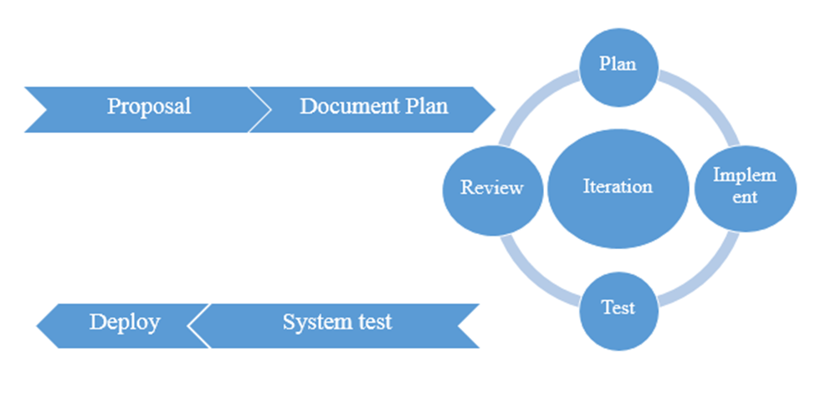
Software Process
Iterative development model
Development process that repeated cycles by starting from the first step until the last step.
Notes:
What will the audience be able to do after this training is complete? Briefly describe each objective how the audience will benefit from this presentation.

Slide 29
Schedule
&
Milestone

Slide 30
Schedule & Milestone
Progress I
Feature#1 Account management
Feature#2 Login/Logout System
Feature#3 Media management
Feature#4 Management Information system
Progress II
Feature#5 Repairing inform system
Feature#6 Repairing report system
Feature#7 Tracking system
Notes:
What will the audience be able to do after this training is complete? Briefly describe each objective how the audience will benefit from this presentation.

Slide 31
Q/A
And thank you
for watching our presentation

